Slide 1
WEEK 7 SIWES PROJECT
ETHICAL RECONNAISSANCE • OSINT AND NMAP
Case study: Axia Hub (using publicly available information and an instructor-provided target IP)
Prepared by: DANIEL OPADOTUN.
Institution: UNIVERSITY OF JOS.
Presentation date: 23rd October 2026
Information gathering, basic port scanning, interpreting results, and reporting.
CYBERSECURITY SIWES • WEEK 7 • 1/12

Slide 2
1. Project objectives
What reconnaissance means and what this exercise aimed to achieve
Reconnaissance is the information-gathering stage of a security assessment. It helps an analyst understand a target before deciding what additional testing is appropriate.
OSINT (Open-Source Intelligence) uses information that is publicly available, such as an organization’s official website and public company profile.
Nmap is a network exploration tool used to identify hosts, examine selected ports, and collect limited information about network services.
Objectives: review Axia Hub’s public-facing information; learn common Nmap command options; test only the instructor-provided target and selected ports where authorized; interpret the output accurately; and document limitations.
Expected learning outcome: explain what the evidence supports—and avoid claiming that a filtered port is open, closed, or vulnerable.
CYBERSECURITY SIWES • WEEK 7 • 2/12

Slide 3
3. OSINT findings about AxiaHuB
Public information reviewed for the case study
Official homepage: describes Axia Hub as a technology and innovation hub and lists activities such as training, coworking, startup incubation, talent outsourcing and community initiatives.
About page: describes initiatives involving university partnerships, high-school impact, startup incubation and job placement.
Technology focus: cybersecurity is listed among the technology skills or areas highlighted by the organization.
Contact page: publishes a location in Jos, Plateau State, and business contact details.
Cross-check: a public LinkedIn company profile also associates Axia Hub with IT services in Jos, Plateau State.
Confidence and limitation: these are observations about what public pages state. Self-published claims were not independently audited, and third-party profiles can become outdated.
CYBERSECURITY SIWES • WEEK 7 • 4/12

Slide 4
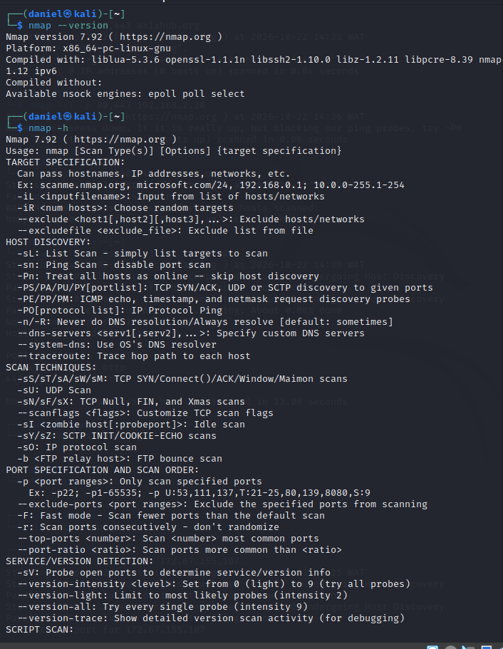
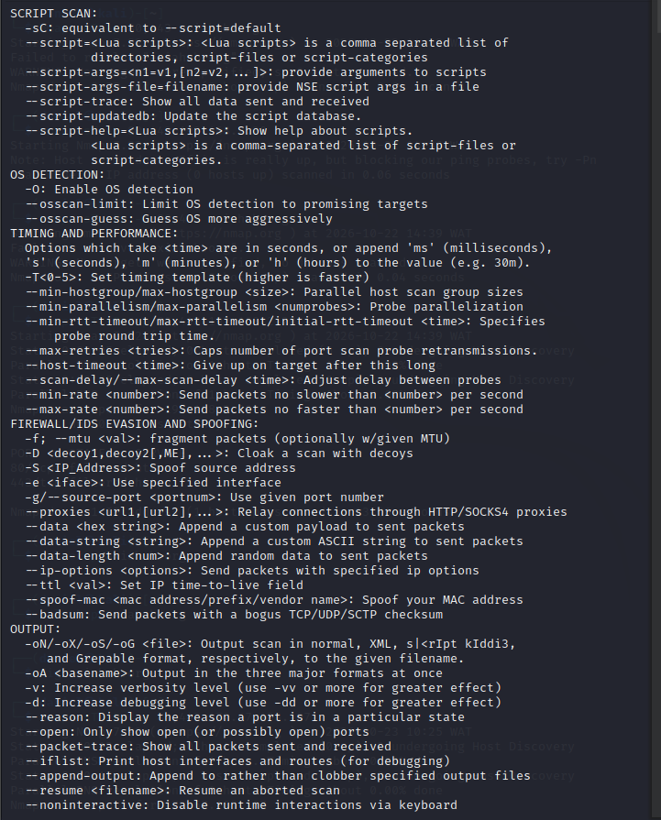
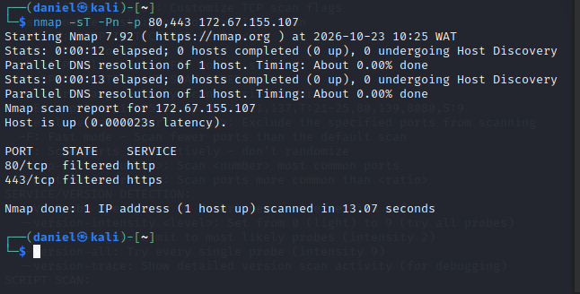
4. Nmap setup and command options
Screenshots 1, 2 and 5: tool setup and help output
The screenshot reports Nmap 7.92 on a 64-bit Linux environment. This confirms the installed tool version visible at the time of capture.
The `nmap -h` help output documents valid command syntax and available features. It is reference information, not proof that every listed feature was executed.
`-sT` selects a TCP connect scan; `-Pn` skips host discovery and treats the target as online for scanning; `-p 80,443` limits the scan to those two ports.
`-oN filename.txt` saves results in normal text format. The filename must come immediately after `-oN`, before the target address.
Other options visible in the help include `-sC` for default scripts and `-O` for operating-system detection. They should only be used when appropriate and authorized.
CYBERSECURITY SIWES • WEEK 6 • 5/12

Slide 5
5. Scan command and target
Screenshot 3: limited TCP scan of the instructor-provided IP
Command shown: `nmap -sT -Pn -p 80,443 172.67.155.107`.
`-sT` asks Nmap to use a TCP connect scan. `-Pn` skips the usual host discovery step, which is useful when discovery probes might not receive replies.
`-p 80,443` tells Nmap to examine only ports 80 and 443, commonly associated with HTTP and HTTPS respectively.
The output reports the host as up and lists both selected ports as `filtered`.
Interpretation: Nmap did not receive enough information to decide whether those ports were open or closed. Filtering, firewall rules, or other network conditions may explain the result.
The result is a point-in-time observation. It is not evidence by itself that the target is vulnerable or that the web service is unavailable to all users.
CYBERSECURITY SIWES • WEEK 6 • 6/12

Slide 6
6. Understanding the result: “filtered”
Open: Nmap receives a response indicating that an application is accepting connections on the port.
Closed: Nmap can reach the target, but no application is listening on that port; the host typically responds that the connection is refused.
Filtered: a firewall, access-control rule, or network condition blocks or interferes with probes, so Nmap cannot reliably determine open versus closed.
For this scan, ports 80/tcp and 443/tcp are both reported as filtered. Therefore, the correct conclusion is that their states could not be determined from this scan.
Do not conclude that Axia Hub has an open port, a closed port, or a confirmed vulnerability based only on these lines. Further testing would require explicit authorization and suitable methods.
CYBERSECURITY SIWES • WEEK 7 • 7/12

Slide 7
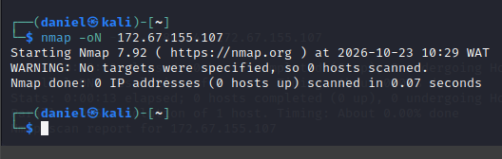
7. Saving output and learning from a syntax error
Screenshot 4: why the first output command failed
The screenshot shows `nmap -oN 172.67.155.107` and Nmap reports that no targets were specified.
Reason: `-oN` expects a filename argument. Without a filename, the IP address is interpreted as the output filename rather than as the scan target.
Correct syntax for a limited, authorised scan: `nmap -sT -Pn -p 80,443 -oN axiahub_scan.txt 172.67.155.107`.
In this corrected command, `axiahub_scan.txt` is the output file and the final argument is the target IP.
Learning point: read command-line options carefully, check error messages, and verify that output files contain the expected command, target, timestamp and results.
CYBERSECURITY SIWES • WEEK 6 • 8/12

Slide 8
8. Practice scans versus target evidence
Why the target must be labelled correctly
Earlier practice screenshots included scans of `127.0.0.1` (localhost) and `192.168.2.20` (a private-network address).
`127.0.0.1` refers to the local machine itself. A result from localhost describes the Kali environment, not Axia Hub.
`192.168.2.20` is a private IPv4 address. Unless a lab specifically maps that address to an authorized target, its scan result must not be presented as a scan of the public Axia Hub target.
CYBERSECURITY SIWES • WEEK 6 • 9/12

Slide 9
9. Evidence quality and limitations
What the screenshots prove—and what they do not prove
Supported by the screenshots: Nmap 7.92 was available; the help menu was consulted; a command was attempted to save output; and a scan of 172.67.155.107 reported ports 80 and 443 as filtered.
Not supported by the screenshots: successful exploitation, proof of a vulnerability, proof that a service is open, or a complete assessment of AxiaHub’s security.
The Nmap help screenshots show available options, not completed scans using every option listed.
An IP address supplied by an instructor is treated as the lab target for this report; the screenshots alone do not independently establish ownership of the IP or the full network scope.
Evidence should be time-stamped, legible and labelled. Keep raw output and record the exact command so another person can understand and reproduce the authorised test.
CYBERSECURITY SIWES • WEEK 6 • 10/12

Slide 10
10. Recommendations and learning outcomes
Practical improvements based on the limited evidence
For the organisation or system owner: review firewall and access-control rules for intended HTTP/HTTPS exposure; confirm that public web services are configured as intended; and monitor logs for unexpected connection attempts.
For the analyst: confirm written scope before scanning; use the smallest necessary port range; record the exact command and time; and avoid interpreting `filtered` as a vulnerability.
For the lab workflow: verify DNS/target information where appropriate, check command syntax, save output with `-oN`, and distinguish target scans from localhost/private-network practice scans.
Skills gained: using Nmap help, choosing basic scan options, interpreting port-state output, correcting an output-file syntax error, and documenting uncertainty.
These recommendations are general and do not imply that a vulnerability was found in AxiaHub.
CYBERSECURITY SIWES • WEEK 6 • 11/12

Slide 11
11. Conclusion and questions
Summary
The project combined public-source OSINT with a limited Nmap exercise using the IP address supplied for the lab.
Public pages provided organisational context, while the Nmap output showed the host as up and ports 80 and 443 as filtered.
The key technical lesson is that filtered ports do not reveal whether a port is open or closed. The key professional lesson is to stay within scope and report only what the evidence supports.
CYBERSECURITY SIWES • WEEK 6 • 12/12

Slide 12
THANK YOU

